Slide 1



University Institute of Engineering
DEPARTMENT OF COMPUTER SCIENCE & ENGINEERING
Subject Name: Software Engineering
Subject Code: 23CST-206
Software Project Management
Er. Jagmeet Kaur
E8387
ASSISTANT PROFESSOR
CSE
DISCOVER . LEARN . EMPOWER

Slide 2
Project scheduling
Risk analysis and management

Slide 3
Project Scheduling
Project-task scheduling is a significant project planning activity.
It comprises deciding which functions would be taken up when.
To schedule the project plan, a software project manager wants to do the following:
Identify all the functions required to complete the project.
Break down large functions into small activities.
Determine the dependency among various activities.
Establish the most likely size for the time duration required to complete the activities.
Allocate resources to activities.
Plan the beginning and ending dates for different activities.
Determine the critical path. A critical way is the group of activities that decide the duration of the project.

Slide 4
Project Scheduling
Project schedule simply means a mechanism that is used to communicate and know about that tasks are needed and has to be done or performed and which organizational resources will be given or allocated to these tasks and in what time duration or time frame work is needed to be performed.
Effective project scheduling leads to success of project, reduced cost, and increased customer satisfaction. Scheduling in project management means to list out activities, deliverables, and milestones within a project that are delivered.
It contains more notes than your average weekly planner notes. The most common and important form of project schedule is Gantt chart.

Slide 5
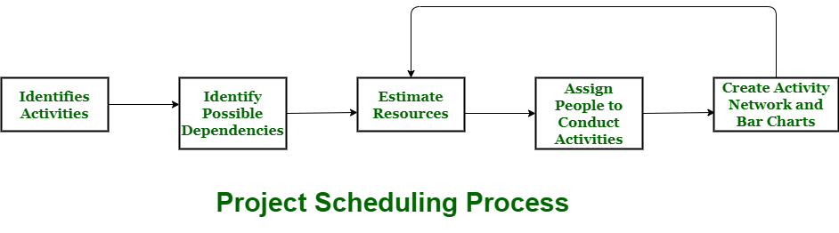
Project Scheduling

Slide 6
Project Scheduling
The first method in scheduling a software plan involves identifying all the functions required to complete the project.
Next, the large functions are broken down into a valid set of small activities which would be assigned to various engineers.
The work breakdown structure formalism supports the manager to breakdown the function systematically after the project manager has broken down the purpose and constructs the work breakdown structure; he has to find the dependency among the activities.

Slide 7
Project Scheduling
Dependency among the various activities determines the order in which the various events would be carried out.
If an activity A necessary the results of another activity B, then activity A must be scheduled after activity B. In general, the function dependencies describe a partial ordering among functions, i.e., each service may precede a subset of other functions, but some functions might not have any precedence ordering describe between them (called concurrent function).
The dependency among the activities is defined in the pattern of an activity network.

Slide 8
Project Scheduling
Once the activity network representation has been processed out, resources are allocated to every activity.
Resource allocation is usually done using a Gantt chart.
After resource allocation is completed, a PERT chart representation is developed.
The PERT chart representation is useful for program monitoring and control.

Slide 9
Project Scheduling
For task scheduling, the project plan needs to decompose the project functions into a set of activities.
The time frame when every activity is to be performed is to be determined.
The end of every action is called a milestone.
The project manager tracks the function of a project by audit the timely completion of the milestones.
If he examines that the milestones start getting delayed, then he has to handle the activities carefully so that the complete deadline can still be met.

Slide 10
Advantages of Project Scheduling
There are several advantages provided by project schedule in our project management:
It simply ensures that everyone remains on same page as far as tasks get completed, dependencies, and deadlines.
It helps in identifying issues early and concerns such as lack or unavailability of resources.
It also helps to identify relationships and to monitor process.
It provides effective budget management and risk mitigation.

Slide 11
Risk Management
What is Risk?
"Tomorrow problems are today's risk."
Hence, a clear definition of a "risk" is a problem that could cause some loss or threaten the progress of the project, but which has not happened yet.
These potential issues might harm cost, schedule or technical success of the project and the quality of our software device, or project team morale.

Slide 12
Risk Management
Risk Management is the system of identifying addressing and eliminating these problems before they can damage the project.
We need to differentiate risks, as potential issues, from the current problems of the project.
Different methods are required to address these two kinds of issues.
For example, staff storage, because we have not been able to select people with the right technical skills is a current problem, but the threat of our technical persons being hired away by the competition is a risk.

Slide 13
Risk Management
A software project can be concerned with a large variety of risks. In order to be adept to systematically identify the significant risks which might affect a software project, it is essential to classify risks into different classes.
The project manager can then check which risks from each class are relevant to the project.
There are three main classifications of risks which can affect a software project:
Project risks
Technical risks
Business risks

Slide 14
Risk Management
Project risks: Project risks concern differ forms of budgetary, schedule, personnel, resource, and customer-related problems.
Since the software is intangible, it is very tough to monitor and control a software project.
It is very tough to control something which cannot be identified. For any manufacturing program, such as the manufacturing of cars, the plan executive can recognize the product taking shape.

Slide 15
Risk Management
2.Technical risks: Technical risks concern potential method, implementation, interfacing, testing, and maintenance issue. It also consists of an ambiguous specification, incomplete specification, changing specification, technical uncertainty, and technical obsolescence. Most technical risks appear due to the development team's insufficient knowledge about the project.
3. Business risks: This type of risks contain risks of building an excellent product that no one need, losing budgetary or personnel commitments, etc.

Slide 16
Other risk categories
1. Known risks: Those risks that can be uncovered after careful assessment of the project program, the business and technical environment in which the plan is being developed, and more reliable data sources (e.g., unrealistic delivery date)
2. Predictable risks: Those risks that are hypothesized from previous project experience (e.g., past turnover)
3. Unpredictable risks: Those risks that can and do occur, but are extremely tough to identify in advance.

Slide 17
Principle of Risk Management
Global Perspective: In this, we review the bigger system description, design, and implementation. We look at the chance and the impact the risk is going to have.
Take a forward-looking view: Consider the threat which may appear in the future and create future plans for directing the next events.
Open Communication: This is to allow the free flow of communications between the client and the team members so that they have certainty about the risks.
Integrated management: In this method risk management is made an integral part of project management.
Continuous process: In this phase, the risks are tracked continuously throughout the risk management paradigm.

Slide 18
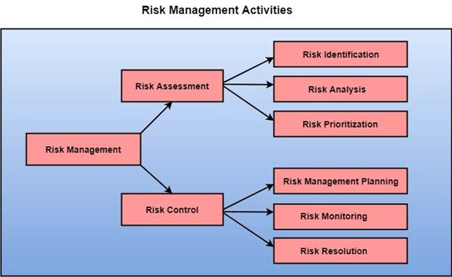
Risk Management Activities
Risk management consists of three main activities, as shown in fig:

Slide 19
Risk Assessment
The objective of risk assessment is to division the risks in the condition of their loss, causing potential. For risk assessment, first, every risk should be rated in two methods:
The possibility of a risk coming true (denoted as r).
The consequence of the issues relates to that risk (denoted as s).
Based on these two methods, the priority of each risk can be estimated:
p = r * s
Where p is the priority with which the risk must be controlled, r is the probability of the risk becoming true, and s is the severity of loss caused due to the risk becoming true. If all identified risks are set up, then the most likely and damaging risks can be controlled first, and more comprehensive risk abatement methods can be designed for these risks.

Slide 20
Risk Identification
The project organizer needs to anticipate the risk in the project as early as possible so that the impact of risk can be reduced by making effective risk management planning.
A project can be of use by a large variety of risk. To identify the significant risk, this might affect a project. It is necessary to categories into the different risk of classes.
There are different types of risks which can affect a software project:
Technology risks: Risks that assume from the software or hardware technologies that are used to develop the system.
People risks: Risks that are connected with the person in the development team.

Slide 21
Risk Identification
Organizational risks: Risks that assume from the organizational environment where the software is being developed.
Tools risks: Risks that assume from the software tools and other support software used to create the system.
Requirement risks: Risks that assume from the changes to the customer requirement and the process of managing the requirements change.
Estimation risks: Risks that assume from the management estimates of the resources required to build the system

Slide 22
Risk Analysis
During the risk analysis process, you have to consider every identified risk and make a perception of the probability and seriousness of that risk.
There is no simple way to do this. You have to rely on your perception and experience of previous projects and the problems that arise in them.
It is not possible to make an exact, the numerical estimate of the probability and seriousness of each risk. Instead, you should authorize the risk to one of several bands:
The probability of the risk might be determined as very low (0-10%), low (10-25%), moderate (25-50%), high (50-75%) or very high (+75%).
The effect of the risk might be determined as catastrophic (threaten the survival of the plan), serious (would cause significant delays), tolerable (delays are within allowed contingency), or insignificant.

Slide 23
Risk Control
It is the process of managing risks to achieve desired outcomes. After all, the identified risks of a plan are determined; the project must be made to include the most harmful and the most likely risks. Different risks need different containment methods. In fact, most risks need ingenuity on the part of the project manager in tackling the risk.
There are three main methods to plan for risk management:
Avoid the risk: This may take several ways such as discussing with the client to change the requirements to decrease the scope of the work, giving incentives to the engineers to avoid the risk of human resources turnover, etc.
Transfer the risk: This method involves getting the risky element developed by a third party, buying insurance cover, etc.
Risk reduction: This means planning method to include the loss due to risk. For instance, if there is a risk that some key personnel might leave, new recruitment can be planned.

Slide 24
Risk Leverage
: To choose between the various methods of handling risk, the project plan must consider the amount of controlling the risk and the corresponding reduction of risk. For this, the risk leverage of the various risks can be estimated.
Risk leverage is the variation in risk exposure divided by the amount of reducing the risk.
Risk leverage = (risk exposure before reduction - risk exposure after reduction) / (cost of reduction)

Slide 25
Risk Leverage
1. Risk planning: The risk planning method considers each of the key risks that have been identified and develop ways to maintain these risks.
For each of the risks, you have to think of the behavior that you may take to minimize the disruption to the plan if the issue identified in the risk occurs.
You also should think about data that you might need to collect while monitoring the plan so that issues can be anticipated.
Again, there is no easy process that can be followed for contingency planning. It rely on the judgment and experience of the project manager.
2. Risk Monitoring: Risk monitoring is the method king that your assumption about the product, process, and business risks has not changed.

Slide 26
References
https://www.geeksforgeeks.org/short-note-on-project-scheduling/
https://www.javatpoint.com/software-engineering-project-scheduling
https://tutorialsinhand.com/tutorials/software-engineering-tutorial/software-project-management/software-project-scheduling.aspx
https://www.geeksforgeeks.org/software-engineering-risk-management/

Slide 27
THANK YOU

